Slide 1
Scientific Calculator Using GUI in python
Presented By Heena
Roll No.- 2107074
CSE 5th Sem

Slide 2
Introduction
Python is a popular programming language. It was created by Guido van Rossum, and released in 1991.
It is user for :
Web development (server-side)
Software development
Mathematics,
System scripting.

Slide 3
About the project
For those who not know, a calculator is basically a program on a calculator that simulates the behaviour of any hand-held calculator useful for performing mathematical calculations, it is very basic device used in our everyday lives. Now al the smartphones also have a calculator application in them.
While creating any GUI application there are mainly two steps:
The first step is to create a user interface.
The second step is the most important one and in this, to add functionalities to the GUI.

Slide 4
System requirement environment
Hardware requirement :
Ram
Processor – intel Pentium 4
Rom -256 GB
Software requirement :
Python 2.7 or about
PyCharm
A good internet connection
Linux ,MacOS, Window7,XP or above

Slide 5
Tools and technophiles
Tools: python
Python Libraries: tkinter,etc.
Tkinter :-tkinter is the standard GUI library for python. Python when combined with tkinter provides a fast and easy way to create GUI applications. Tkinter provides a powerful object-oriented interface to the Tk GUI toolkit.

Slide 6
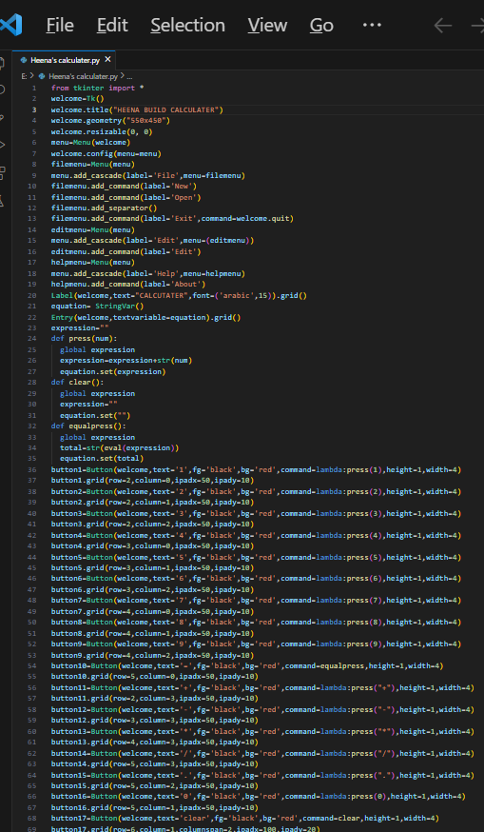
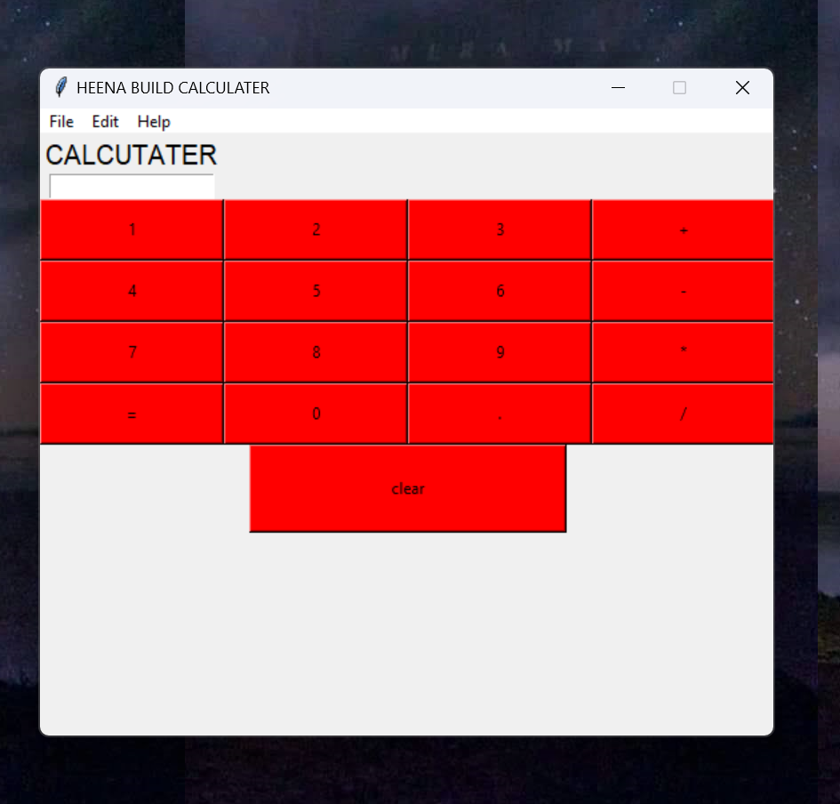
Output

Slide 7
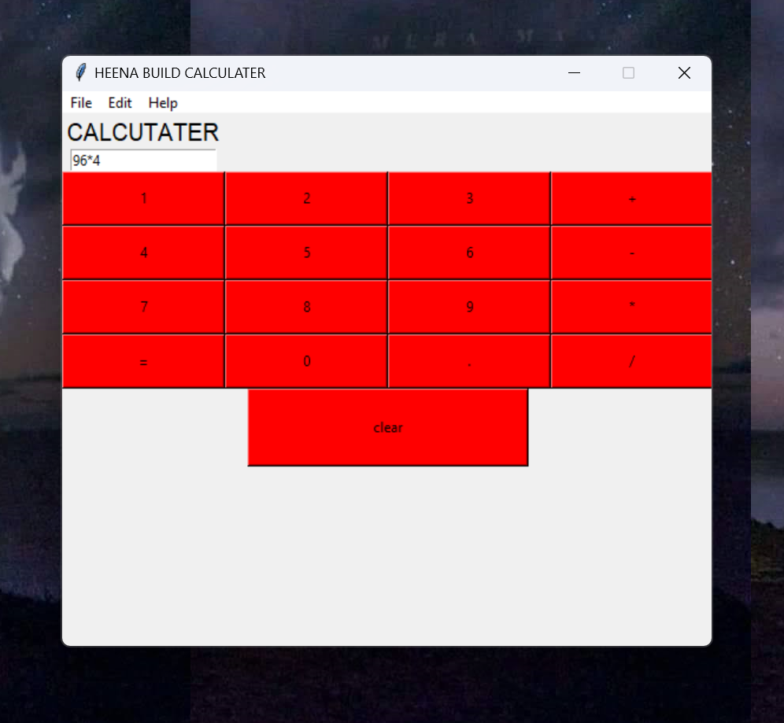
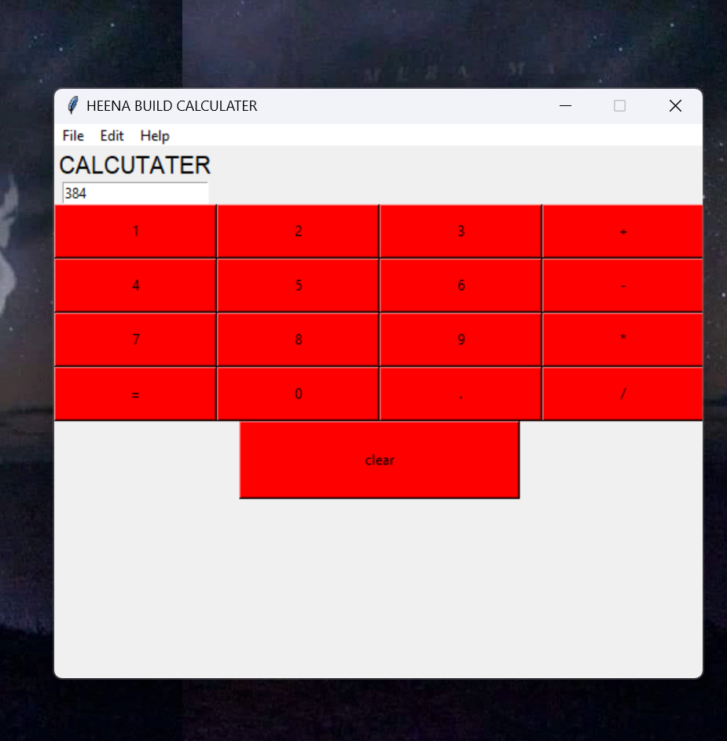
Output

Slide 8

Thank you

